Slide 1
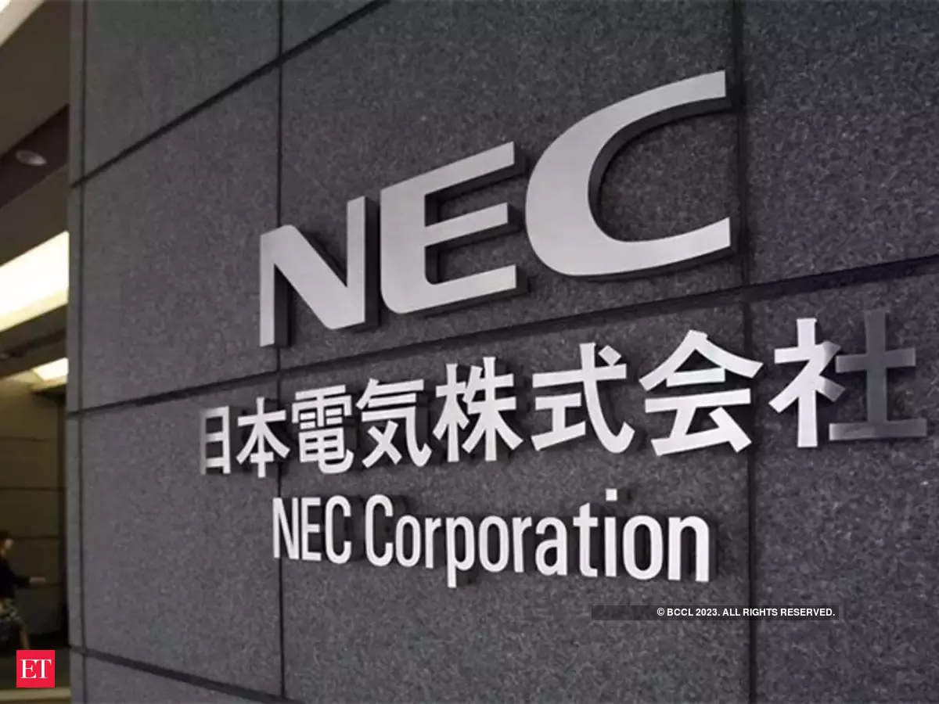

Slide 2

INTRODUCTION
TO
COMPANY

Slide 3
INTRODUCTION TO NEC
NEC Corporation is a multinational IT company.
Founded in 1899 in Tokyo , Japan.
It’s full name was Nippon Electric Company , Limited.
It was renamed in 1983 as NEC Corporation.
“EMPOWERED BY INNOVATION” is its slogan.
As of March 31,2008 it had 153,992 employees.
Revenue is 4,617.2 billion.
NEC Semiconductors is among the world Wide Top 20 Semiconductor Sales Leaders.

Slide 4
ABOUT
HISTORY

Slide 5

HISTORY OF NEC
Company Formation
Partnership was established between Kunihiko Iwadare and Takeshiro Maeda .
In August 31, 1898.
Both related to Miyoshi Electrical Manufacturing Company.
Western Electrical Company was interested in Japanese Phone market.
On 17 July 1899 NEC and WEC of USA agreed on joint venture. It was first Japanese joint venture of foreign capital.

Slide 6
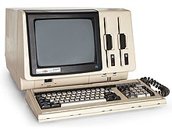
FIRST PRODUCT FORMED BY NEC
In September 1958, NEC built their first fully transistorized computer.
Named the NEAC-2201, with parts made solely in Japan.
One year later, they demonstrated it at the UNESCO AUTOMATH show in Paris.
The company began integrated circuit research and development in 1960.

Slide 7
TECHNOLOGY USED IN EARLY STAGES
NEC's Early Years: NEC initially focused on telecommunication technologies during its early stages.
Telecommunication Infrastructure: NEC played a pivotal role in developing early switching systems and communication networks.
Transistor Technology: In the mid-20th century, NEC embraced transistor technology, contributing to the miniaturization and advancement of electronic devices.
Mainframe Computers: NEC entered the mainframe computer market with their NEAC1101 and NEAC1102 , developing large-scale computing systems for business and scientific applications.

Slide 8
TECHNOLOGY USED IN EARLY STAGES
5. Semiconductor Innovations: NEC became a leader in
semiconductor technology, development of memory chips and micro
processors.
6. Global Expansion: NEC expanded its operations globally by
contributing to the international technology landscape.
7. Research and Development: NEC invested heavily in research and
development, fostering innovation across a range of technological
domains.
8. Telecommunications Standards: NEC played a role in contributing
to the evolution of communication protocols and systems.

Slide 9
ADVANTAGES OF EARLY PRODUCTS THAT WAS BUILT BY NEC
Innovation.
Reliability.
Telecommunication Advancements.
Infrastructure Development.
Market Expansion.
Global Reach.
Longevity.

Slide 10
LIMITATIONS OF EARLY PRODUCTS THAT WAS BUILT BY NEC
Limited Features.
High Cost.
Maintenance Challenges.
Scalability Issues.
Dependency on Infrastructure.
Limited Compatibility.

Slide 11
TECHNOLOGICAL EVOLUTION OF COMPANY OVER THE YEARS
Early Years (1899-1940s):- NEC was founded in 1899 as a telegraph equipment repair shop. It gradually expanded into the production of telecommunications equipment, including telephone switches and transmission equipment.
Post-WWII and Telecommunications (1950s-1980s):- After World War II, NEC continued to focus on telecommunications. It played a significant role in the development of Japan's telecommunication infrastructure, including the introduction of digital switching systems.

Slide 12
Computing and IT (1960s-1980s):- In the 1960s, NEC entered the computer industry, producing mainframes and minicomputers. It continued to expand its computing offerings throughout the 1970s and 1980s.
Semiconductors (1970s-1990s):- NEC became a major player in the semiconductor industry, developing integrated circuits (ICs) and microprocessors. Its semiconductor division was a key contributor to the technology industry.
Global Expansion (1980s-2000s):- NEC expanded globally, establishing subsidiaries and joint ventures in various countries, contributing to the global technology landscape.

Slide 13
Mobile Technology (1990s-Present):- NEC developed mobile phones and infrastructure equipment, becoming a significant player in the mobile technology industry.
Information and Communication Technologies (ICT) (2000s-Present):- NEC continued to diversify into various ICT areas, including cloud computing, biometrics, and cyber security.
Research and Innovation (Ongoing):- NEC has a strong focus on research and innovation, particularly in areas like AI, quantum computing, and advanced network solutions.

Slide 14
ADVANTAGES OF PRODUCTS OF NEC AFTER EVOLUTION OF TECHNOLOGY
Quality.
Security.
Energy Efficiency.
Global Presence.
Scalability.
Remote Accessibility.
Continuous Software Updates.

Slide 15
LIMITATIONS OF PRODUCTS OF NEC COMPANY AFTER EVOLUTION OF TECHNOLOGY
Prices.
Complexity.
Support And Maintenance.
Global Variations.
Competitions.
Compatibility.
Environmental Impact.

Slide 16
FUTURISTIC GOALS OF NEC COMPANY WITH RESPECT TO TECHNOLOGY
Quantum Computing.
Artificial Intelligence And Machine Learning.
6G And Beyond.
Sustainability And Green Technology.
Cyber Security.
Biotechnology And Healthcare.
Smart Cities And IOT.
Space Technology.
Human-Machine Interaction.

Slide 17
Achievements by NEC
The discovery of single-walled carbon nanotubes by Sumio Iijima
The invention of the widely used MUX-scan design for test methodology (contrast with the IBM-developed level-sensitive scan design methodology)
The world's first demonstration of the one-qubit rotation gate in solid state devices.
As for mobile phones, NEC pioneered key technologies like color displays, 3G support, dual screens and camera modules.
Developed a facial recognition system able to detect and distinguish human faces through medical masks.
Released the first home console video game system to use compact discs, being the first widely available product to use compact discs as a platform for interactive video entertainment outside of home computer use

Slide 18
Projects of Nec in india
· AADHAAR, a nationwide digital identity system, enabling 1.3 billion Indians to access a wide range of valuable services·
Submarine cable project, powering high- speed internet in the Andamans, opening a world of possibilities for the islanders·
Biometric airport solutions enable faces to become boarding passes under the new normal·
A comprehensive suite of AI-based biometric systems and solutions to ensure trust and keep India and its residents safe·

Slide 19
Projects of Nec in india
Real-time visualization systems to enable efficient and seamless logistics systems.
“Over 6,000 employees and partners have worked tirelessly to create a measurable impact in the journey to make India a digitally enabled society.

